Slide 1
VMware Tanzu GemFire Made Simple with Spring Caching
Charlie Black
Director of Product, VMware GemFire
Notes:
Click to add notes

Slide 2
What is VMware Tanzu GemFire?
Some common usage patterns for GemFire
Some GemFire Features
What is Spring Caching
How to Use Spring Caching With GemFire
Real World Performance Numbers

Slide 3
What is VMware GemFire?

Slide 4

VMware GemFire is an enterprise grade, high speed in-memory data and compute grid for high-performance, low latency applications where data must be consistent, up to date and delivered with sub-millisecond response times at scale, across multiple data centers

Slide 5
VMware GemFire is an enterprise grade, high speed in-memory data and compute grid for high-performance, low latency applications where data must be consistent, up to date and delivered with sub-millisecond response times at scale, across multiple data centers
Fast!!!
Makes it AWESOME for caching!

Slide 6


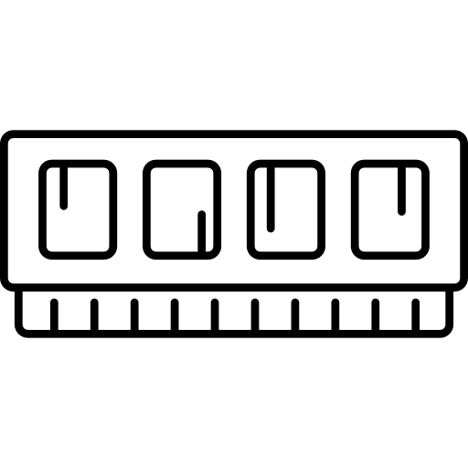

Memory Biased Performance
Shared Nothing Architecture
10X to 100X faster than
Traditional DBMS
Optionally – reliably write updates to disk,
or to a data warehouse, asynchronously or synchronously.

Slide 7

Elastic and Scalable
Add/remove data servers dynamically
Grow or shrink dynamically
with no interruption of service or data loss.

Slide 8


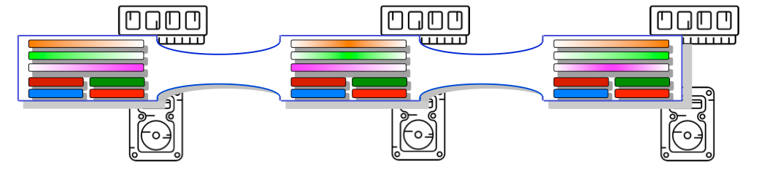

Common GemFire Data Storage Patterns
System Of
Record
Cache
Aside
Read / Write
Through
Write
Behind
Refresh Ahead
Or
Hot Cache
Notes:
Tell story on one.

Slide 9





Where can GemFire Run?
Public Cloud
Private Cloud
Hybrid Cloud
Bare Metal

Slide 10
Definition: Region
Region /rējən/
A named concurrent map of which holds key value pairs.

Slide 11

How does it work?
Some App
// Insert or update a customer record into the cache
customerRegion .put(customerIdX, customerObjX);
put(key,value)
get(key)
Region
// Retrieve a customer record from the cache
Customer customerY = customerRegion .get(customerIdY);
Regions implement ConcurrentMap<K,V>
aka – Key Value Store

Slide 12
How does it work?
Query Language: OQL (Object Query Language)
SELECT p, pos
FROM /exampleRegion p, p.positions.values pos
WHERE pos.secId = ‘VMW'

Slide 13
Event Driven Architecture
Pub/Sub
Continuous Query
put(
,
)
SELECT * FROM /tradeOrder t
WHERE t.price > 100.00
In Process - Competing consumer pattern with asynchronous or synchronous delivery

Slide 14
GemFire Data Resiliency Concepts
Data Redundancy
Replicated Regions: data is copied to all nodes.
Best for reference data that needs to be everywhere
Partitioned Regions: data is partitioned with a redundancy factor.
Allows for scale
Automatically restores redundancy when there is an issue
Infrastructure redundancy
Redundancy Zones: Allows for a “zone” faults to not impact GemFire data availability
WAN: Enables GemFire to span globe

Slide 15
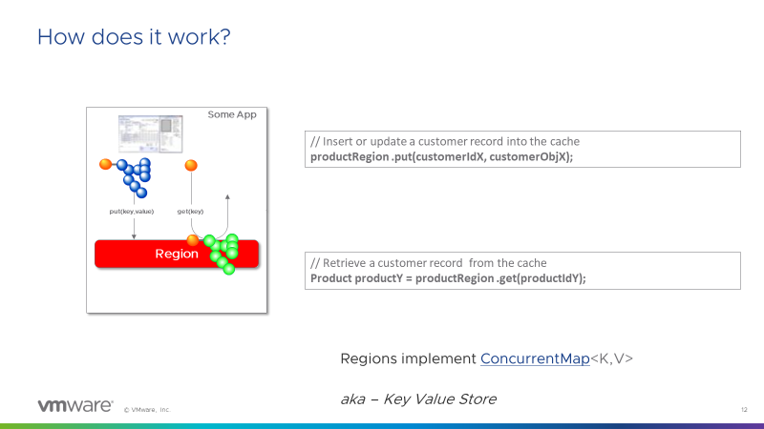
GemFire Redundancy Sounds Complicated - It’s Not!
How to Make Replicated Region
Create The Region
Application
gfsh>create region --name=Products
--type=REPLICATE
Products
Products
Products
All data is replicated across all the GemFire servers

Slide 16
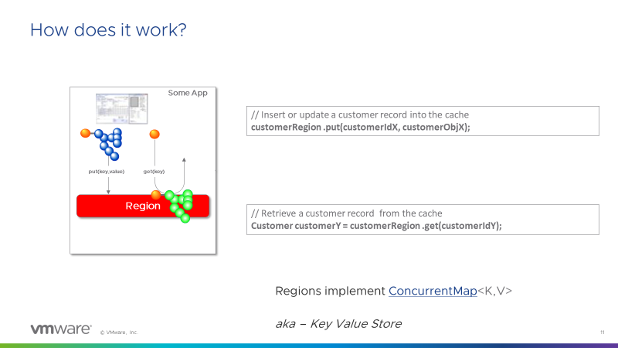
GemFire Redundancy Sounds Complicated – It’s Not!
How to Make Partition Region
Create The Region
Application
gfsh>create region --name=Customers
--type=PARTITION --redundant-copies=2
Customers_{R}
Customers
Customers
Customers_{R}
Customers_{R}
Customers
Customers’
Customers’
Customers’
Customers’
Customers’
Customers’
GemFire keeps the data balanced and safe all automatically and dynamically!!!

Slide 17

GemFire Redundancy Sounds Complicated – It’s Not!
How to Make Partition Region
Create The Region
Application
gfsh>create region --name=Customers
--type=PARTITION --redundant-copies=2
Customers_{R}
Customers
Customers
Customers_{R}
Customers_{R}
Customers
Customers’
Customers’
Customers’
Customers’
Customers’
Customers’
Customers’
Customers’
GemFire keeps the data balanced and safe all automatically and dynamically!!!

Slide 18

Infrastructure Redundancy
Geographically Distributed
Serial Gateway Sender
Parallel Gateway Sender
Parallel Gateway Sender
Parallel Gateway Sender
Serial Gateway
Parallel Gateway

Slide 19

VMware GemFire Use Cases
Enterprises need a fit-for-purpose data store for predictable low latency performance
Low-Latency Data Access Quick response times and high-speed data access. Query response times get to double-digit milliseconds (at best) with traditional DBs, single-digit with GemFire
Scaling for high read frequency high cost to scale since traditional DBs require a ton of read replicas to match what a single cache may deliver
Customers using traditional relational databases for low-latency applications run into challenges
Simplify Data Access Relational DBs are not optimal when apps may want to access data in a particular structure or to increase app performance (JSON payloads or Data Objects)
Low-Latency Cache for Disconnected microservices Modern apps need a data tier to store their state. Without a cache inserted in the architecture, modern apps cannot deliver a speedy response to concurrent data requests.
In-Memory Compute Business logic executed close where data is collocated, for blazing speed in critical use cases (Ticketing, Fraud Detection, etc…) across WAN-based deployments for extremely HA and critical apps.

Slide 20
Spring Caching

Slide 21
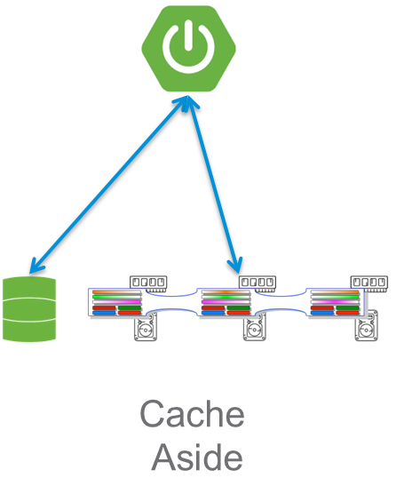
Spring Caching
Caching done easy
Value
Key
Provide Transparent caching to an application
Performance
Cost
Done through adding @Cacheable to an applications method
Method Parameters Turn into a Key
Value the method returns is the Value
From a GemFire perspective an implementation of the cache aside pattern
public int add(int x, int y){ return x + y; }

Slide 22
Spring Caching
Key Annotations
@Cacheable triggers cache population
@CacheEvict triggers cache eviction
@CachePut updates the cache without interfering with the method execution
https://docs.spring.io/spring-framework/docs/current/javadoc-api/org/springframework/cache/annotation/package-summary.html
Notes:
https://docs.spring.io/spring-framework/docs/current/javadoc-api/org/springframework/cache/annotation/package-summary.html

Slide 23
Real World Example

Slide 24

Spring Caching
Real World Application – What we are going to cache

Slide 25


Spring Caching
Real World Application - Architecture
Call the “Value Add” Service and measure performance
$ ./gradlew bootRun
https://bikeindex.org:443/api/v3/search
create region
--name=bikecache
--type=PARTITION
--entry-time-to-live-expiration=60
--entry-time-to-live-expiration-action=destroy
--enable-statistics=true

Slide 26
Spring Caching
Real World Application – The “Value Add” wrapping of Bike Index REST API
@EnableCachingDefinedRegions //Tell Spring to use GemFire @SpringBootApplication @RestController public class DemoApplication { @Cacheable("bikecache") @RequestMapping("/search") public String search(@RequestParam(value = "page", required = false, defaultValue = "1") int page, @RequestParam(value = "per_page", required = false, defaultValue = "25") int perPage, @RequestParam(value = "location", required = true) int location, @RequestParam(value = "distance", required = false, defaultValue = "10") int distance, @RequestParam(value = "stolenness", required = false, defaultValue = "proximity") String stolenness)
throws IOException, URISyntaxException { return callRestService(getUri(page, perPage, location, distance, stolenness)); }
…
public static void main(String[] args) { System.out.println("DemoApplication.main"); SpringApplication.run(DemoApplication.class, args); } }

Slide 27
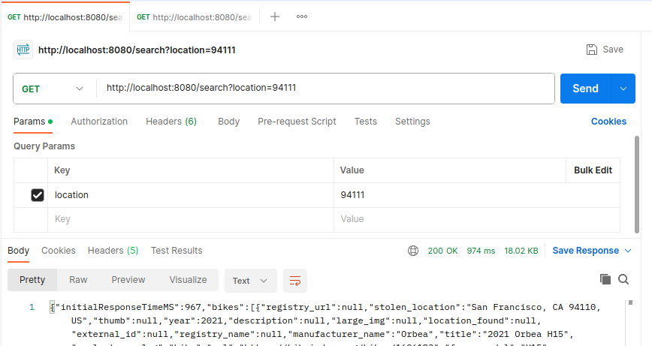
Spring Caching
Cache Miss Call Using Postman

Slide 28
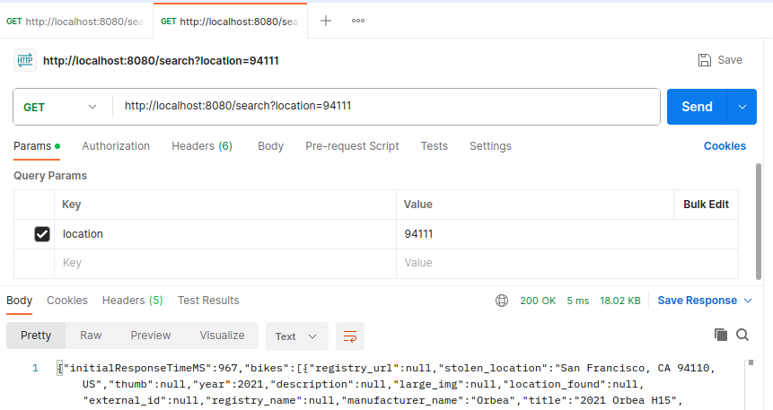

Spring Caching
Cache Hit Call Using Postman
195 X Faster!!!
5ms vs 974ms

Slide 29
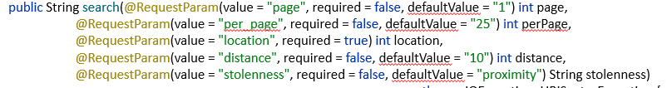
Spring Caching
What it looks like in GemFire
gfsh>query --query="select * from /bikecache.entries"
Result : true
Limit : 100
Rows : 1
SimpleKey [1,25,94111,10,proximity]
-----------------------------------------------------------------------"{\"initialResponseTimeMS\":967,\"bikes\":[{\"registry_url\":null,\"st

Slide 30
Recap
We discussed:
What is GemFire and how to use it
How to keep your data safe with GemFire from a server, rack or datacenter fault
How GemFire can keep your systems running around the globe
Some use cases around GemFire
Used Spring Caching and Observed a 195 X performance increase

Slide 31
Resources
To learn more head over to: https://gemfire.dev/
Documentation
Download
Examples
Blogs
Videos
Source Code for slides: https://github.com/charliemblack/gemfire-cacheable-rest-demo

